Slide 1

DASH BOARD DESIGNING
Tejitha Chakka
Data Analyst Intern

Slide 2

Objective
The main goal of this task is to design an interactive dashboard which helps to study business and monitor the data of the dataset like key performance indicators like Sales, profit , and growth using Power bi and make the visualizations in a concise way which help the stakeholders.

Slide 3
Dataset Used
Source: Kaggle – vehicle sales dataset
Description: contains records of
Selling price
model
state
seller
sold date
body
make
Year
color etc.

Slide 4

Key Metrics
Total sales
Year by year growth
Sales by region / color of vechile / body / make / model

Slide 5

DashBoard Features
Filters/Slicers: Region, Category, Date Range
Time-Series Charts: Monthly/Quarterly trends
Summary Cards: Total Sales, Profit, GrowthConsistent
Color Theme & Clean Layout

Slide 6
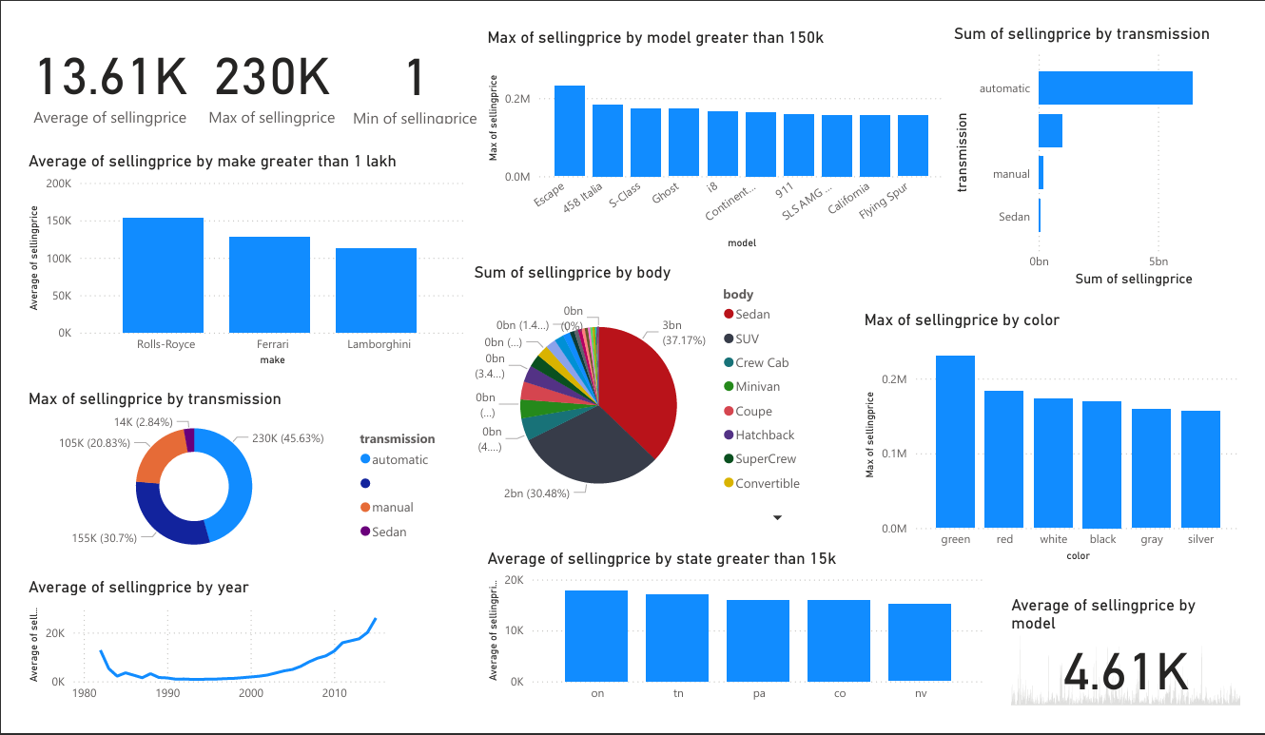
Dashboard Screen shots

Slide 7
Insights
shows the highest sales across all regions
Category A outperforms others in both sales and profit
Region X has low sales but high profitability
Seasonal trends affect customer buying behavior
.
.

Slide 8
Tools Used
Power BI / Tableau
Excel (for preprocessing)
GitHub (for code & documentation)
.
.

Slide 9
Conclusion
This dashboard provides a comprehensive view of business performance.Stakeholders can use the insights to optimize strategy, improve regional focus, and track trends over time.
.
.

